Slide 1
Intake & Continuation Insights for HIV Prevention Pills in Kenya
Prepared for JHG by: Candidate ID MPI_40131
Date: 09/08/2025

Slide 2
Overview
HIV preventive pills have been freely available to all Kenyans at multiple clinics across the country. However, despite this availability, the initial uptake and continued use of these pills has decreased over time.
This analysis investigated trends in the use and continuation of the HIV pills to confirm whether the low continuation rates are a result of behavioral issues.
Common patterns leading to discontinued use were identified and appropriate intervention plans have been provided in this report.

Slide 3
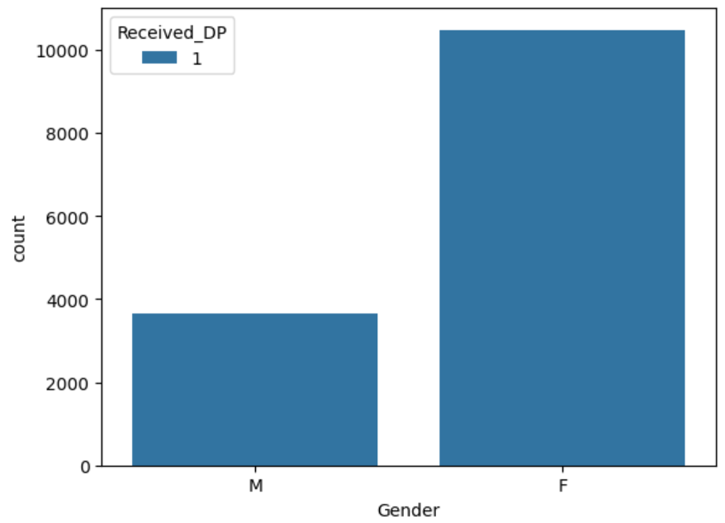
Understanding the Demographic
The patients who received the pills were mostly females and the most predominant age range comprised of young adults in their teens to early thirties. (fig 1)
All patients who visited the clinics received the initial dose but many declined continuation immediately after the first month. (table 1)
Fig 1:
Uptake | No. of Patients
Initial Uptake | 14137
1st month refill | 6765
2nd month refill | 3920
3rd month refill | 2571
6th month refill | 958
Table 1:

Slide 4
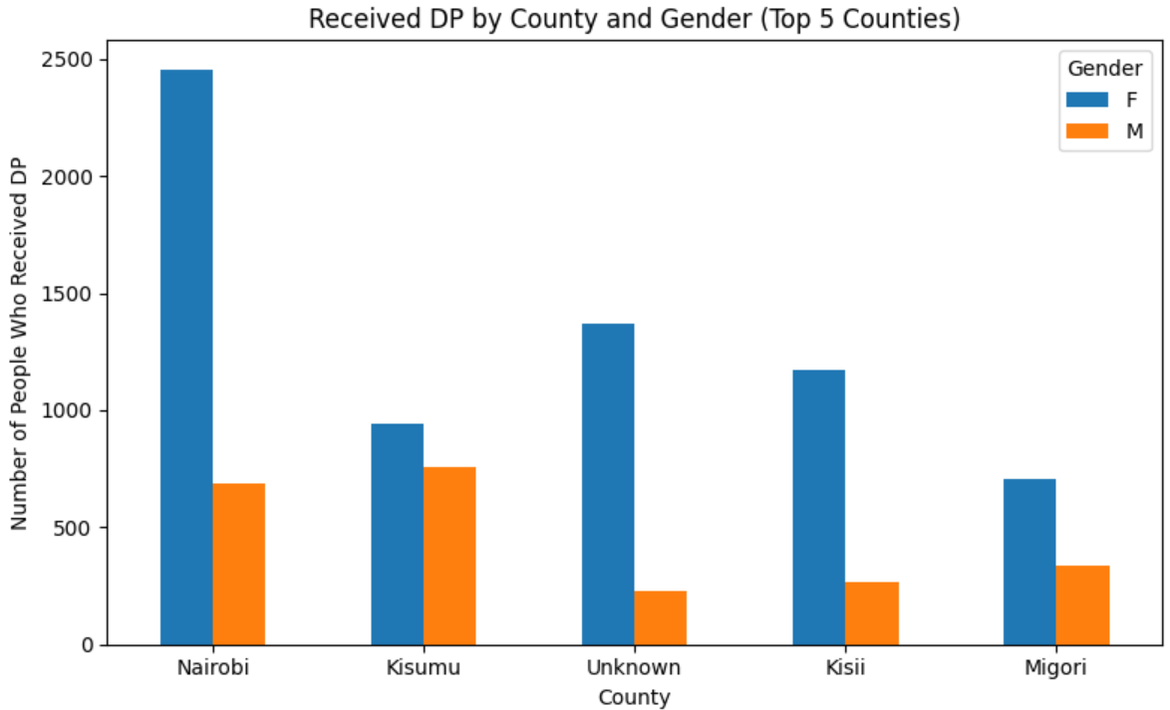
DP Pills Distribution by County & Gender
Nairobi and Kisii had the highest number of people who received the pills.
Despite the region, it is notable that male expressed less interest in the pills compared to females.

Slide 5
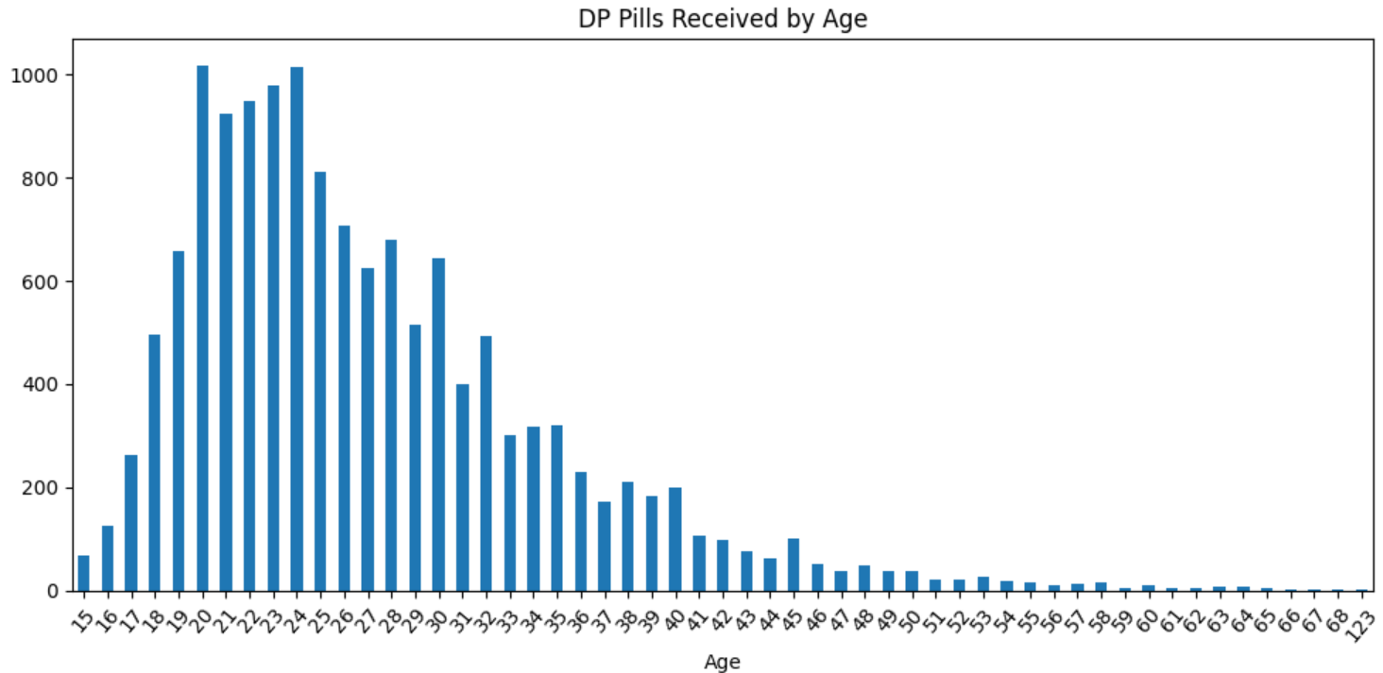
DP Distribution by Age
As aforementioned, the most predominant age range comprised of young adults in their teens to early thirties.
This is an indication that the main users of the DP pills are relatively young

Slide 6
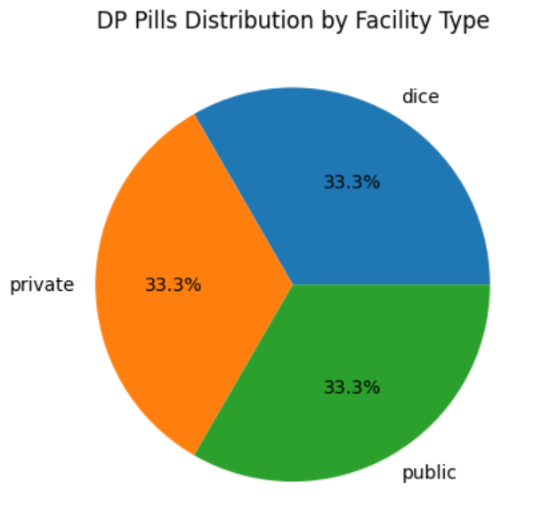
Impact of Facility Type on DP Distribution
Facility type was found out to not be a differentiating factor in initial uptake of the DP pills.
This is an indication that whether the facility is public, private, or dice, it does not significantly affect initial uptake of the pills.

Slide 7
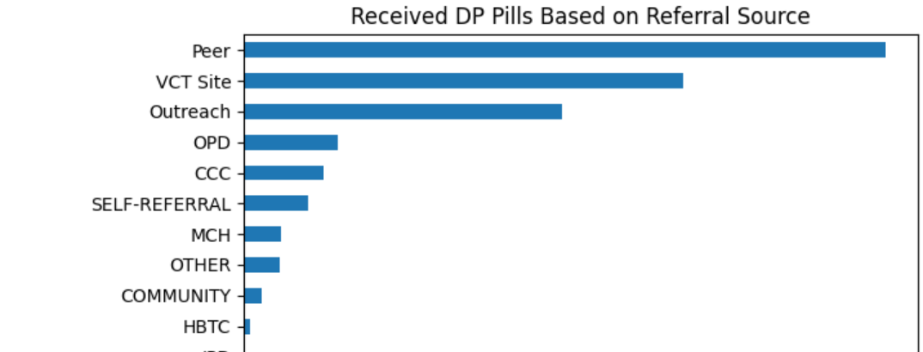
Referral Types and their Impact on DP Intake
The type of referral or the transfer-from facility had a significant impact on initial intake of DP pills
Many patients had been referred by their peers and the majority of transfers were from VCT sites.
This is an indication that peer referrals are a strong driver for initial uptake of the pills.

Slide 8
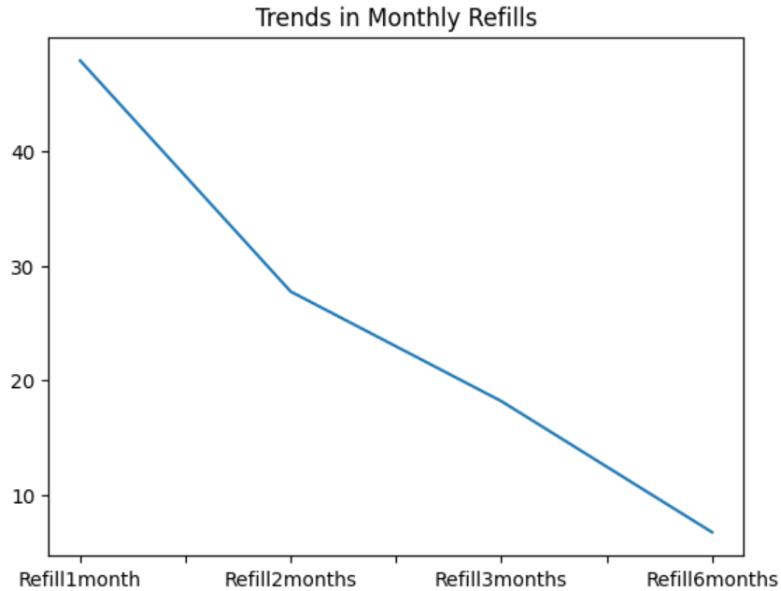
DP Intake Continuation Trends
All enrolled patients received the initial 30-pills package
The highest drop-off occurred in the first month and a large number of the patients did not return after the initial refill.
In the second and third refill, there were more declines.
Only few patients refilled till the 6th month indicating low continuation in the long run.

Slide 9
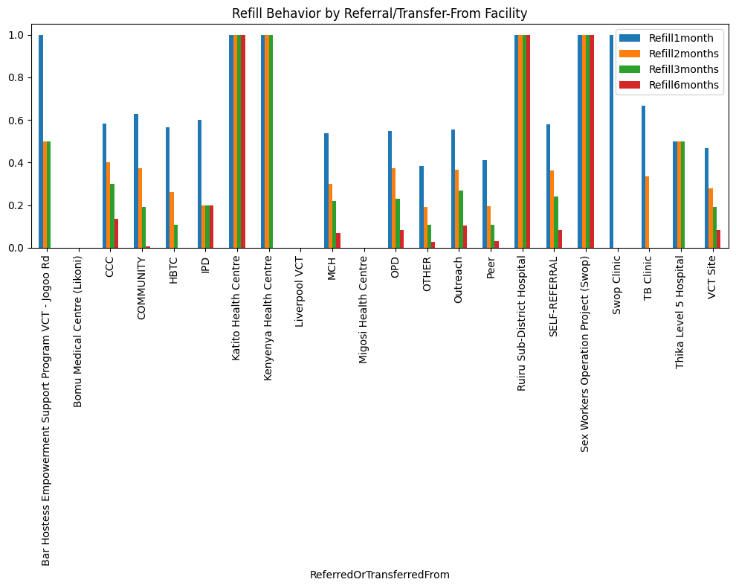
Refill Behavior Based on Referral/Transfer-From Facility
Despite peer referrals and VCT sites having the highest initial DP intakes as noted earlier, they experienced low continuation rates as seen in the chart.
Some centers ensured patients adhered to the program from initial uptake to the last refill.
Empowerment programs contributed to the highest continuation rates

Slide 10
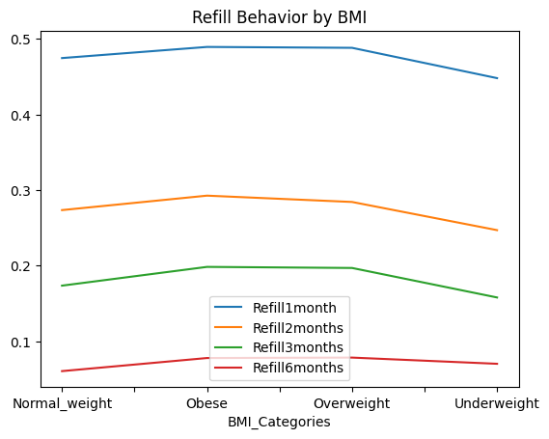
Impacts of BMI on DP Continuation Rates
The patients were classified into standard BMI categories.
As seen in the line graph, patients with normal weight had the largest share of refills with underweight patients maintaining an almost stable refill rate.
Refill rates are significantly low by the 6th month refill across all BMI categories, indicating that BMI has no impact on refill trends in the long run.

Slide 11
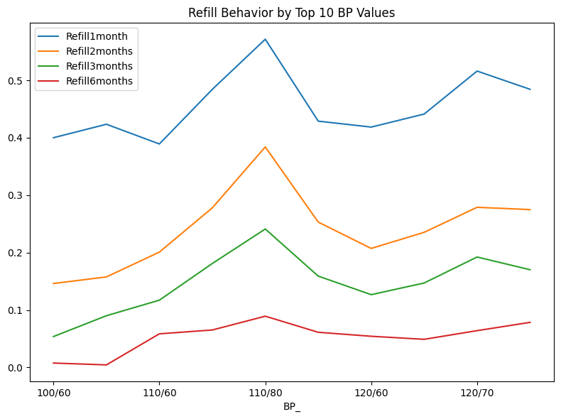
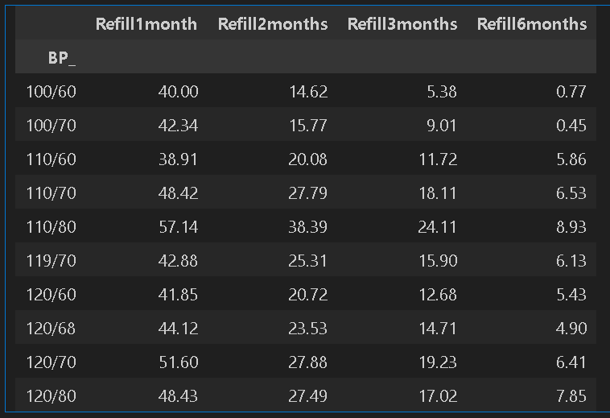
Impacts of BP on Continuation Rate
Lower BP have high 1st month refill rates.
Mid to high BP rates have a higher longer term refill percentage rate
The trend does not show proper consistency indicating that there are other major factors influencing behavior.

Slide 12
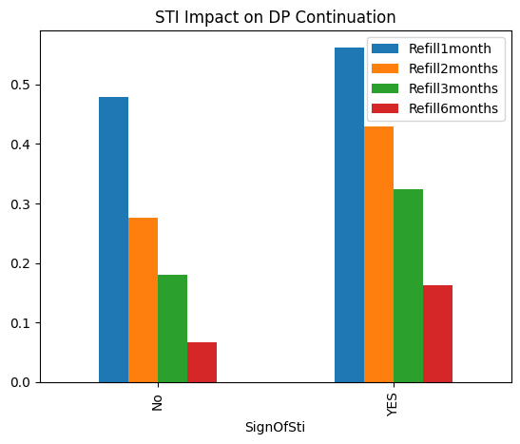
STI Impact on DP Continuation
There is a clear influence of STI on DP pills continuation
Clients with STI had a high continuation rate in the first month which later dropped in the following months.
This shows that after STI diagnosis, there was a high motivation among patients to take care of their health, which reduced afterwards.

Slide 13
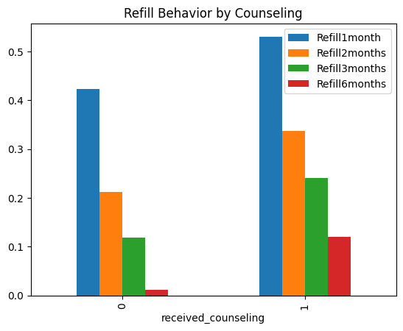
Effects of Counselling on DP Continuation
Clients who received counselling had the highest 1st month refill rates which dropped gradually in the consequent months. This is a sign of motivation which increased adherence in the initial stages.
This is a clear indication of the need for follow up support to maintain adherence through out the program.

Slide 14
Intervention/Improvements for DP Continuation Rates
Summary Findings
JHG is experiencing very low continuation rates especially in the long run.
Health issues such as BP and BMI have shown minimal impact on continuation rates
There seems to be consistent behavioral patterns affecting continuation including:
Referral sources
Counselling services
Signs of STI also influenced continuation rate in the short term as well as county and gender.
Recommended Intervention as Per Summary Findings
The best intervention would be to ensure targeted ongoing counselling and follow ups, particularly after the first month for sustained continuation rates especially in the long run.

Slide 15
Evaluating the Intervention
The suggested intervention is capable of increasing initial25% DP uptake by 25% and continuation rates by 30%. This is because with a targeted approach on counselling and follow-ups, it will be possible to reach the target audience and encourage motivation thus increasing adherence to the program.
A better way to assess the effectiveness of this intervention would be to ensure proper data collection on follow-up support in the clinics and further analysis on incoming clients and their reason/motivation for taking the pills.

